Slide 1


Agentic AI with LangChain and LangGraph
Presentation 8: Intro to Deep Agent and Miscellaneous Items
Primary Instructor: Michael Z
RA: YH
Date: 2026.Jan-Feb

Slide 2
0. Deep Agent

Slide 3
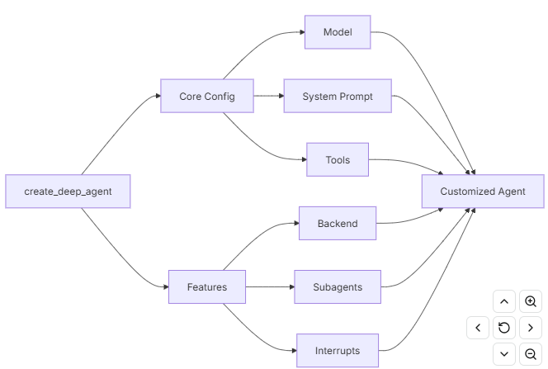
0. Deep Agent: Quickstart (Skipped)
Deep Agent = regular ReAct agent + a list of langchain-provided default tools + planning capabilities + context management through file system……
According to LangChain docs, it seems Deep Agent is ReAct Agent Pro Max.
Since Deep Agent is really similar to regular ReAct agent, I won’t repeat what I discussed before but talking something new.

Slide 4
0. Deep Agent: Subagents
You could provide some subagents to main Deep Agent so that main Deep Agent could focus on high-level planning and task decomposition and subagents could be called to work on specific sub-tasks.
You could add a dictionary, which is basically agent configuration file in the list and main Deep Agent would create the agent behind the scene, or a complied LangGraph graph (the StateGraph we discussed in the “Intro to LangGraph”, such as agentic workflow or multi-agents).
(Unfortunately, the example provided by LangChain is not that good but you could get it.)
I would go over the docs for you very quick.

Slide 5
1. Agent Skills

Slide 6
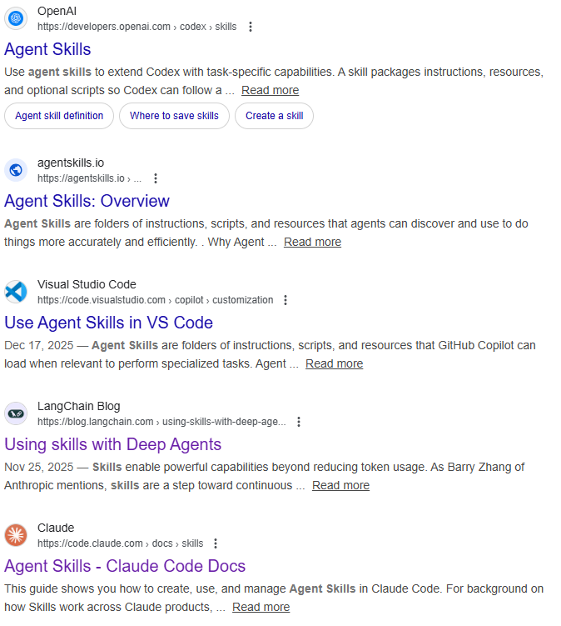
1. Agent Skills: What is it?
It’s mainly advertised by Anthropic.
TL;DR: agent calls the tool to load information from files it needs to respond to user query. The information is basically skill.
It looks like RAG but using tool to retrieve text information it needs, rather than embedding model and vector store.
I would go over the example for you very quick.
https://docs.langchain.com/oss/python/langchain/multi-agent/skills-sql-assistant

Slide 7
2. Research Frontiers in AI Agent

Slide 8

2. Research Frontiers in AI Agent: Multi-Modal Agent
The agent we have learned so far could only handle plain text……
Why is Multi-Modal Agent hard to build?
(I might ask a lot of questions….)

Slide 9
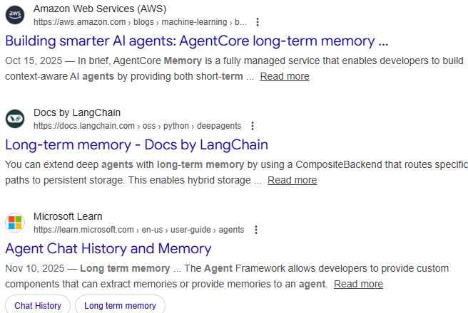
2. Research Frontiers in AI Agent: Long Term Memory
Long Term memory is still not mature…
What do you think about how long-term memory is supposed to work in AI agent?

Slide 10
3. Career Opportunities in LangChain Ecosystem

Slide 11
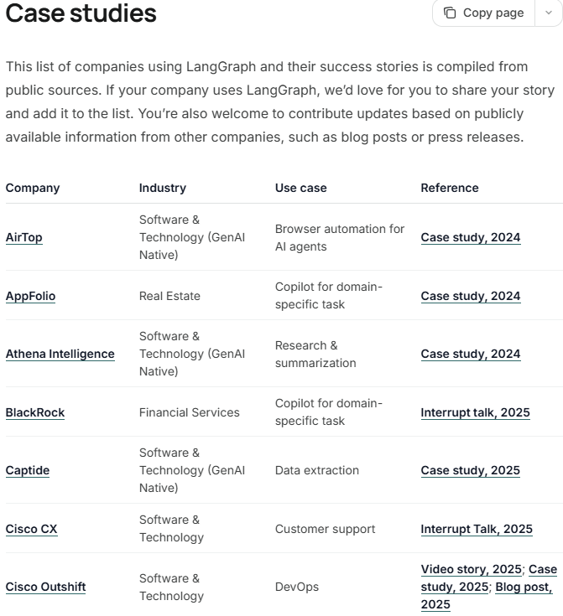
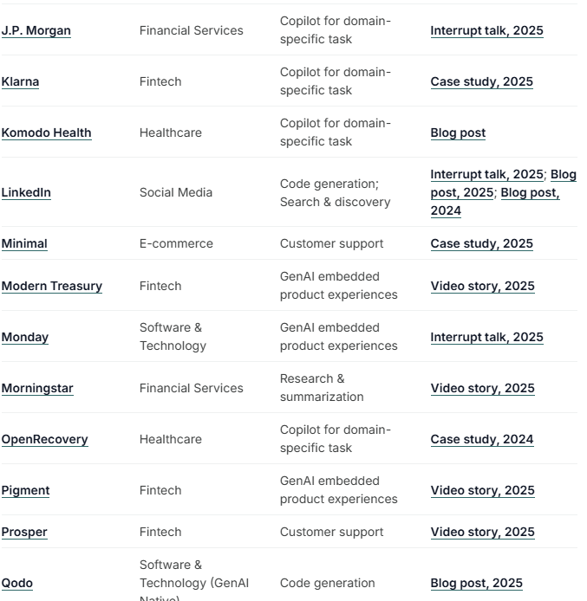
3. Career Opportunities in LangChain Ecosystem: These Companies…..

Slide 12
4. Quick Review
(You can ask me some questions about what I covered so far)

Slide 13
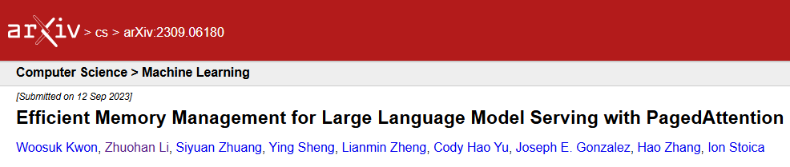
Thank you for your paged attention!

Slide 14


